Slide 1
School Representative Program
Or what the heck did I sign up for…

Slide 2
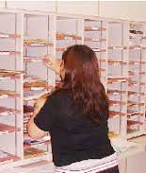
School Representatives
Some think the role of the school representative is to support the Local and disseminate information.

Slide 3
What the role really entails…
Engage
Communicate
Represent
Inform

Slide 4
Engage
As a school representative you…
Facilitate participation in the local
Link teachers to the ATA

Slide 5
Communicate
As a school representative you…
Ensure Teachers in your local hear information from the ATA
Ensure The ata hears from your teachers

Slide 6
Represent
As a school representative you…
Represent the views of the teachers at local council meetings
Represent the Local and the ATA at school staff meetings

Slide 7
Inform
As a school representative you…
Maintain an ATA resource library
Distribute information to colleagues

Slide 8
Communications

Slide 9
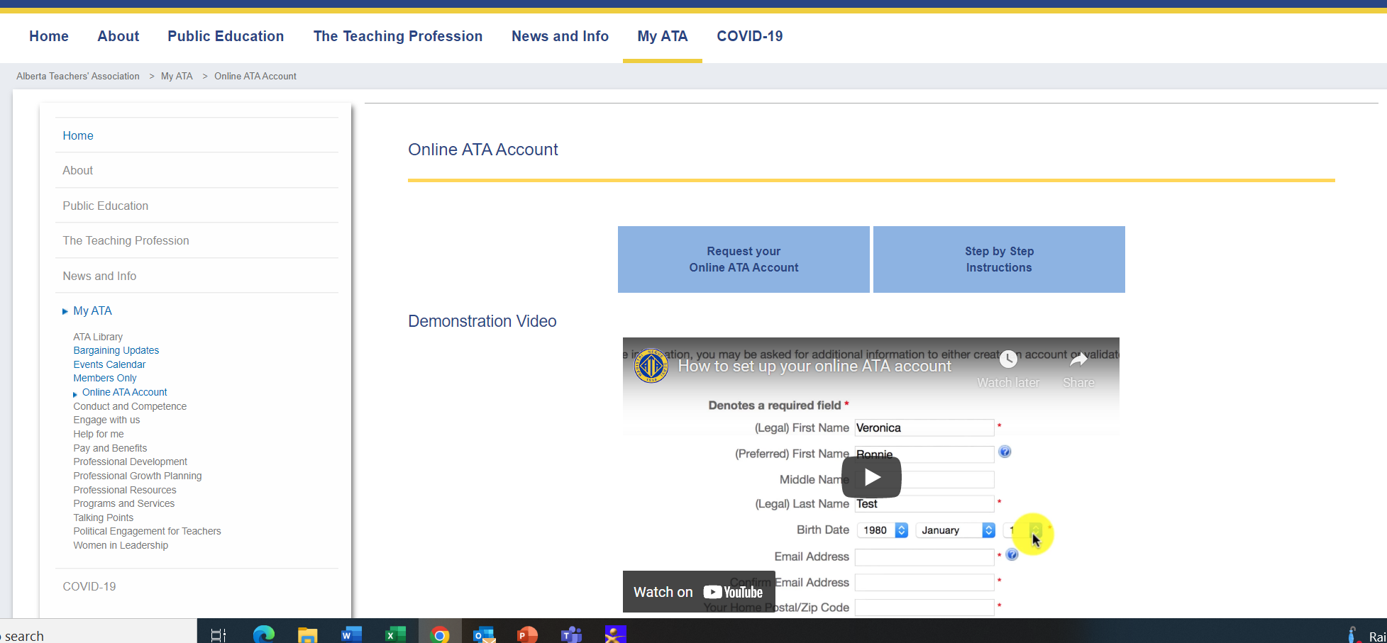
Sign Up for/Update Your Online Account
www.teachers.ab.ca
Notes:
One important role you will have as a school representative is to encourage all members to create an online account and update it as information changes.
This helps us to stay in contact with our members and it is also necessary in order to access services such as the ATA Library and a complimentary specialist council membership.
To set up a new account or to update information, members should go to the ATA website – www.teachers.ab.ca
Click the Login button on the top right of the toolbar.
If you have any difficulties logging in, please contact the ATA’s IT Help Desk at 1-800-232-7208.

Slide 10
Reasons to get your Online ATA Account
Notes:
The Members Only area of the Association website is restricted and not accessible to the public. Given the Members Only area houses vital tools, services and information, there are many reasons for ATA members to get an online ATA account, and to keep it updated. Here are six great ones:

Slide 11
Get Bargaining Updates
When the bargaining of collective agreements is imminent or underway, regular updates and other information critical to keeping you informed of developments will be posted in the Members Only section of the Association website.

Slide 12
Vote on provincial collective agreements
Ratification votes by teachers on the provincial collective agreements negotiated between the Alberta Teachers’ Association and the Teachers’ Employer Bargaining Association will be conducted exclusively online. Get your online ATA account to be sure you are able to vote.

Slide 13
Vote in ATA elections
Provincial Executive Council conducts the business of the Association and is made up of 20 members, 18 of whom are elected by you. Council listens to and represents teachers from across the province and brings their voices to the table when determining Association strategies and actions.

Slide 14
Use ATA library online resources and databases
Use ATA library online resources and databases The ATA library has an extensive collection of books, periodicals, videos and other materials focusing on educational research and professional development for teachers. Library services and materials are available in both French and English.

Slide 15
Get no-cost ATA specialist council memberships
As a benefit of ATA membership, active members are entitled to join one specialist council of their choice each year at no cost.

Slide 16
Print your own ATA member card
The Association launched online self-serve membership card distribution in 2016. With an online ATA account, you have the convenience of printing your own ATA member card from the Association website when you need it. ATA member cards are useful when your identification as a teacher or member of an association is needed to attend events, receive discounts or be eligible for other offers from retailers and service providers.

Slide 17
To print your ATA member card from a desktop computer
sign into the Association website www.teachers.ab.ca. (Click Login, located in the dark blue bar at the top of the page) Go to the Legacy site.
scroll down the page to find My Online Account in grey letters, to the right side of the screen
click Update your profile (note that if you’re not yet signed into ATA Online Services that you will be prompted to log in)
select the Member Card tab and view the sample member card displayed
select View My Member Card and view an image of your actual member card
select Print My Member Card and you're done!

Slide 18
The School Representative as a Liaison
Teachers
School Representative
Provincial Association
ATA Local
Notes:
The school representative is the key link between the provincial Association and its members.
Provincial Executive Council (PEC) and Association staff are keenly aware of the strength the Association has in its field-based representatives.
When you assume the role of school representative, you make programs work and you make the Association effective.
The Association asks that every local ensures that there is a named representative in each school. School representatives play a leadership role in ensuring effective communication and advocacy on behalf of the Association.
There are several responsibilities associated with being a school representative and they are illustrated in this visual:
The SR is the link between teachers at the school and the ATA local.
The ATA Local is also the link to the Provincial ATA.
Communications and advocacy flow through these relationships.

Slide 19
Bring forward local school issues at a Local or CSR meeting.
Notes:
It is important that the communication not be “broadcast only” (i.e. from the provincial ATA to the locals, through to the schools).
As a school representative, it is important to listen to colleagues and bring their issues and questions forward to local ATA meetings.
It is also important to let teachers know when important local meeting and activities occur, and encourage involvement.

Slide 20
Communicate with your local on issues at the school level.
Notes:
It is important that the communication not be “broadcast only” (i.e. from the provincial ATA to the locals, through to the schools).
As a school representative, it is important to listen to colleagues and bring their issues and questions forward to local ATA meetings.
It is also important to let teachers know when important local meeting and activities occur, and encourage involvement.

Slide 21
Ensure information is readily available
Notes:
As a SR, you will receive a school mailing once per month that contains a variety of materials including conference flyers, new information monographs, etc.
There are a variety of ways these materials can be made visible in your staff room area.

Slide 22
Distribute Association Materials
ATA News
ATA Magazine
Members’ Update
School Mailings
Notes:
As the SR, you are also responsible for distributing Association materials delivered to your school.
Receiving Association publications is a benefit of membership, so it is important that materials are distributed as soon as possible (time-sensitive materials may also be present).
If you wish to adjust the number of publications you receive, please consult the SR handbook

Slide 23
Encourage attendance at general meetings and local activities.
Notes:
It is important that the communication not be “broadcast only” (i.e. from the provincial ATA to the locals, through to the schools).
As a school representative, it is important to listen to colleagues and bring their issues and questions forward to local ATA meetings.
It is also important to let teachers know when important local meeting and activities occur, and encourage involvement.

Slide 24
An Overview of School Representative Tasks
The yearly calendar outlines tasks that a SR typically does throughout the year.
Other SR learning modules will describe and outline the tasks described in greater detail.
Notes:
In the SR toolkit, there is a yearly calendar that outlines some of the tasks that are typical during a school year.
Additional learning modules and the SR toolkit describe these tasks in greater detail.
**Note: Provide time for participants to view the yearly calendar and add their own ideas.

Slide 25
Direct colleagues to relevant resources and support when they are in need of advice.
Calgary
350, 6815 8 Street NE Calgary, Alberta T2E 7H7
Phone: 403-265-2672
Toll Free: 1-800-332-1280
Edmonton
11010 142 Street NW Edmonton, Alberta T5N 2R1
Phone: 780-447-9400
Toll Free: 1-800-232-7208
Notes:
You will also:
Direct colleagues to relevant resources and support when they are in need of advice.
Work with your school principal to access appropriate time on the staff meeting agenda for Association information and discussion.

Slide 26
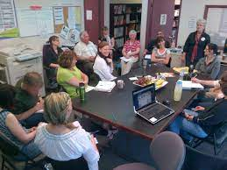
Work with your school principal to ensure appropriate time on the staff meeting agenda for Association information.

Slide 27
The SR Role Is NOT
A representative of colleagues in disciplinary or evaluation meetings
Notes:
There are a few things that SRs must not become involved in, such as:
Representing colleagues in disciplinary or evaluation meetings
Providing legal advice on employment matters.
Interpreting the local collective agreement.
Advising colleagues on matters which can potentially result in a violation of the code of professional conduct.

Slide 28
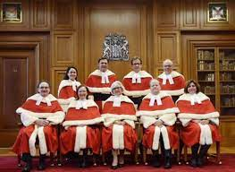
The SR Role Is NOT
A provider of legal advice on employment matters
Notes:
There are a few things that SRs must not become involved in, such as:
Representing colleagues in disciplinary or evaluation meetings
Providing legal advice on employment matters.
Interpreting the local collective agreement.
Advising colleagues on matters which can potentially result in a violation of the code of professional conduct.

Slide 29
The SR Role Is NOT
An interpreter of the collective agreemen
Notes:
There are a few things that SRs must not become involved in, such as:
Representing colleagues in disciplinary or evaluation meetings
Providing legal advice on employment matters.
Interpreting the local collective agreement.
Advising colleagues on matters which can potentially result in a violation of the code of professional conduct.

Slide 30
The SR Role Is NOT
An advisor of colleagues on matters that can potentially result in a violation of the Code of Professional Conduct for Teachers and Teacher Leaders
Notes:
There are a few things that SRs must not become involved in, such as:
Representing colleagues in disciplinary or evaluation meetings
Providing legal advice on employment matters.
Interpreting the local collective agreement.
Advising colleagues on matters which can potentially result in a violation of the code of professional conduct.

Slide 31
When in Doubt …
Call the provincial Association for help— 1-800-232-7208.
Notes:
Acting in areas where you are not authorized may expose you to legal action or charges under the Code of Professional Conduct.
Your actions as school representative need not and should not put you at risk with your employer or your colleagues.
If you have questions, call the Association for help.
A list of contact numbers can be found in the SR Toolkit, on the ATA website and in the ATA Member’s Handbook.

Slide 32
remember…
Acting in areas where you are not authorized may expose you to legal action or charges under the Code of Professional Conduct.
Notes:
Acting in areas where you are not authorized may expose you to legal action or charges under the Code of Professional Conduct.
Your actions as school representative need not and should not put you at risk with your employer or your colleagues.
If you have questions, call the Association for help.
A list of contact numbers can be found in the SR Toolkit, on the ATA website and in the ATA Member’s Handbook.

Slide 33
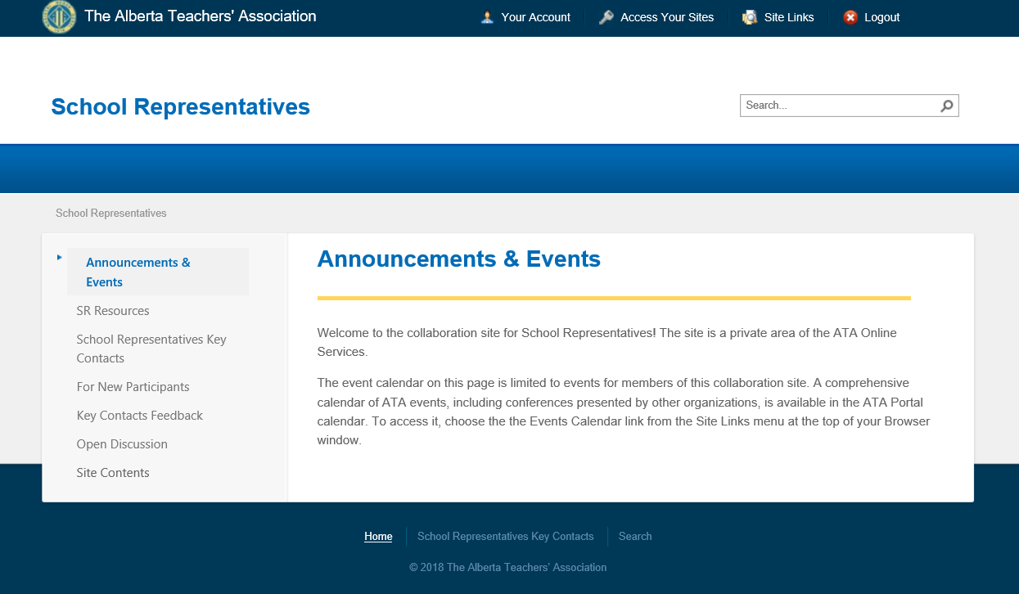
Electronic Resources for School Reps
https://collaboration.teachers.ab.ca/sr
Notes:
School Representatives have a dedicated online space where key information, templates and tools can be found.
Each school has access to the digital School Representative Toolkit to assist school representatives in understanding and engaging in their role.
This information is also available online on the School Representative Collaboration site at https://collaboration.teachers.ab.ca/sr
As materials in the toolkit are updated or developed, information in the toolkit can be replaced.
If your school has a physical binder, it should be passed onto new school representatives and stay at the school.
New school representatives should be given the URL to the SR online space so they can access existing and new materials.
School Representatives will need an ATA login to access this site.

Slide 34
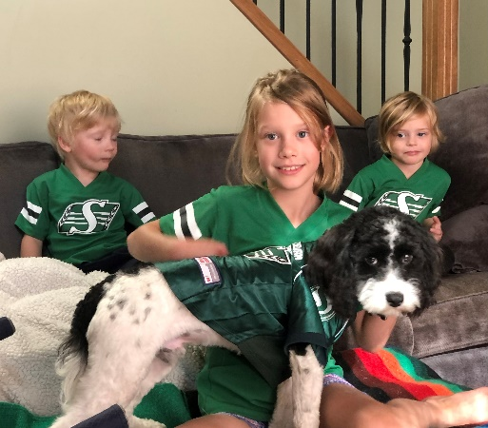
Thank you
Shelley Magnusson,
Executive Staff Officer
The Alberta Teachers' Association
780-447-9478
Shelley.Magnusson@ata.ab.ca

